Slide 1
Switching
Switching architectures
Blocking
Buffering
Notes:
In this lecture we will look at some of the architectures that are used to achieve switching in networks. We will look at the problem of blocking that happens when one network connection makes other connections impossible and the related issue of buffering that arises when there is contention for a resource.
For additional material on this topic see
Telecommunications Switching, Traffic and Networks by J.E.Flood
and
Optical Networks, A Practical Perspective by Ramaswami and Sivarajan

Slide 2
Full Crosspoint Switch
Single stage
  crossbar
  connects any input to any output
Contention
N x N switch
N inputs
N outputs
controller
Notes:
The general fully interconnected crosspoint switch is able to connect any combination of inputs to any combination of outputs. An example of such a switch fabric is the crossbar switch named after its early implementation in the form of movable bars which could be pushed to form connections. In order to achieve the correct connectivity in the network, the switch has some form of controller which makes the appropriate connections. In order or the controller to make the right decisions it needs to know something about the state of the input lines and their data and also about the output lines and their data. In a connection orientated network the switch connections are negotiated as part of the call set up. Each call may last a different time and so the switch makes connections as and when calls are set up.
In a packet network the switch operation will depend on the nature of the network. If packets are of fixed size and synchronous then the switch setup can be changed on a packet by packet basis and only information about the input needs to be obtained. If the packets are of variable size then the switch can either fragment them input equal sized pieces or it has to maintain output state knowledge as well.
Contention occurs when two or more inputs have data for a single output. In a connection orientated network the call would be refused as insufficient resource is available. In a connectionless network the switch could simply drop the packet but there are better things that could be done as we will discuss.

Slide 3
Crossbar Switch
Cross points can be connected
packet and circuit switching
inputs and outputs can be different numbers
switch size scales as N²
Notes:
The crossbar switch can be thought of as (logically this is always so but in the early days they were actually made like this) two orthogonal sets of lines which can be connected at the crossover points. The connections are determined by the controller.
The switch has been used both in circuit switching and in packet switching and is suitable for use both in synchronous and asynchronous applications.
Once the crosspoint is connected the data can flow through the switch, in the slide two connections are shown from input to output. It is not necessary for the number of inputs and outputs to be the same and this feature is often used in concentrators and expanders.
The switch size scales with the square of the number of lines (for a symmetric switch) . So for a large network the cost of such switches would eventually dominate the network costs. Fortunately it is possible to design switches with better scaling properties.

Slide 4
2 layer switch
2
3x3
5
only uses 6*9 = 54 crosspoints rather than 9*9 = 81
penalty is loss of connectivity
Notes:
In the slide we show a 2-layer switch. The example is for a nine by nine switch composed of six three by three switches. The smaller switches are arranged in two layers, the first layer is connected to the input and the second to the output
The outputs of the first switch in the top left are all connected to the first input of one of the three output switches. This switch has a total of 54 crosspoints which is smaller than the 81 used by the fully interconnected switch. So, have we gained something for nothing? The switch has full interconnectivity in that every output can be reached from every input. However, there are some combinations of connectivity which cannot be achieved. Suppose input 2 is connected to output 5, it is no longer possible to simultaneously connect either of inputs 1 or 3 to outputs 4 or 6. This is because there is only one line from each of the input switches to each of the output switches. This situation is known as blocking. We can get round the blocking problem by including an extra layer of switches between the input and the output.

Slide 5
3 layer switch
Connect
2-5 as before
1-6
3-4
Blocking still possible
Notes:
The three stage network shown in this slide does not have the blocking problem that the two stage network had. The original connection between 2 and 5 can be made but now we can also connect 1 to 6 and 3 to 4 at the same time. The switch still blocks but we need to put four connections in place before we see this.
However it now uses 81 crosspoints which is the same as the fully interconnected switch that we started with. In general, this type of network will use more crosspoints if we want it to avoid the blocking problem.
The breakthrough in switch design was made by Clos in 1953 when he showed how switches could be designed with fewer than N² connections without blocking the network.

Slide 6
Blocked 3 layer switch
*
*
Notes:
In this slide we show the same nine by nine three layer switch in a blocked state. The first four connections have made it impossible to connect the third input to the seventh output, as marked by the asterisks.
The third input can only reach the bottom middle switch whereas the seventh output line can only be reached from the top output switch.

Slide 7
Blocking
Blocking
  When a connection is made it can exclude the possibility of certain other connections being made
Non-blocking
  A new connection can always be made without disturbing the existing connections
    wide sense: provided the correct connection rule is applied
    strict sense: any connection rule will do
Rearrangeably non-blocking
  A new connection can be made but it might be necessary to reconfigure some other connections on the switch
Notes:
We have already used the terms blocking and non-blocking which have fairly obvious definitions shown here.
The non-blocking switches are further divided into two sets. Wide-sense non-blocking requires a certain rule for setting up connections to be followed in order to avoid getting into a blocked state. Strict-sense non-blocking switches can use any valid path at any time.
There is a further class of switch networks known as rearrangably non-blocking. In such switches it is always possible to connect a given set of inputs to a given (valid of course) set of outputs. However, when a new connection is required it may not ‘fit’ with the existing set of connections and new paths have to be found for the old connections as well as the new one.

Slide 8
Clos Network
nxp
gxg
pxn
g switches
p switches
g switches
Notes:
Clos worked out how to design networks of switches such that the number of crosspoints could be less than that of a simple crossbar switch.
In the example shown here we consider a three layer switch with n by p gates in the input and output layer and g by g gates in the middle layer. If N is the number of input lines then we have N = ng. The layers are connected in the same manner as the previous switches we have considered but only a few connections are shown here.
The blocking example we have just considered occurs when n-1 lines are tied up on an input switch and n-1 lines are tied up on a single output switch and they are all connected to different middle switches. If this happens then the addition of one more switch would enable the final call to get through. Thus we arrive at the result that the minimum number of switches p in the middle layer is (n-1) +(n-1)+1 to give 2n-1. So the number of crosspoints is
for large n this is minimum when
and at this value there are crosspoints.
Note that each of these switches could itself be a Clos network allowing a recursive design process.

Slide 9
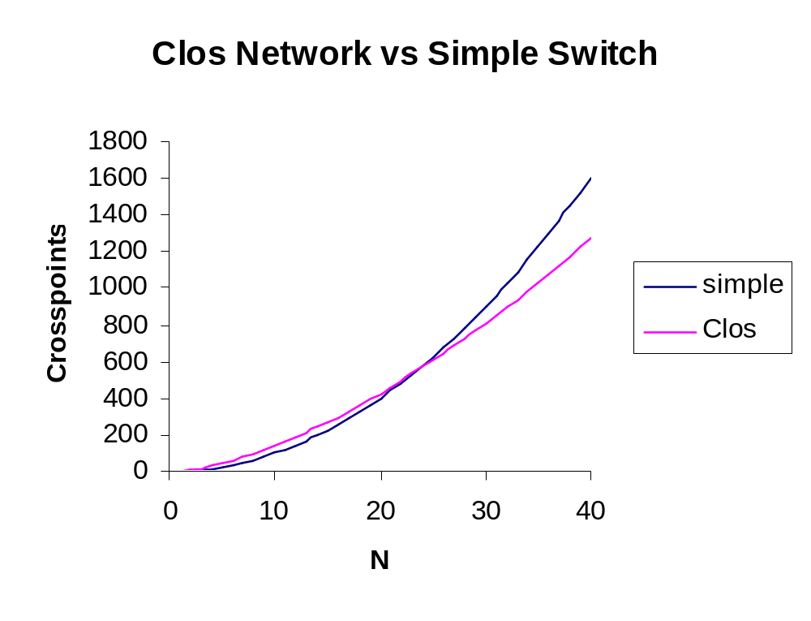
Notes:
This graph shows the comparison between the 3 stage Clos network and a simple switch with N² crosspoints. For large switches the Clos network can produce a saving while guaranteeing non-blocking performance.

Slide 10
Benes Network
Rearrangably non-blocking
e.g.
2 to 1
, 1 to 5
, 3 to 3
, 4 to 2
Notes:
This slide shows a sequence of connections that results in a blocked state. The connections (2,1), (1,5) and (3,3) are made and then a request for (4,2) comes in. As you can see from the blue lines the existing state of the crosspoints forces the connection must fail since there is no way for the two ends to meet.

Slide 11
Benes Network
Now use different connections
e.g.
2 to 1
, 1 to 5
, 3 to 3
, 4 to 2
Notes:
In this slide we will take the same set of connections but now use different paths through the switch in order to allow all of them to be connected. The difficulty in operating this kind of rearrangeably non-blocking switch lies in finding the algorithm for finding the correct combination of settings.
If there are n crosspoints each with two possible settings then there are 2^{n} possible states of the switch.This is very bad when it comes to scaling the problem since the size of the search space grows exponentially with the number of crosspoints. For small switches we could work out once only the settings for each combination of input to output connections of which there are
N! Where N is the number of inputs to the switch.
The real reason for wanting to use switches like this is that the number of crosspoints required is
which is much smaller than N².

Slide 12
Dilated Switches
Optical Switches
  crosstalk can be a problem
  limits number of switches in network
  use dilation
Doubles the isolation in dB
Notes:
Optical switching is likely to be one of the key technologies of the future. One problem encountered in optical switches is that of isolation of the undesired output.
The first diagram shows a two by two optical switch in the bar state. The dotted arrow shows that some of the signal is leaking to the unwanted output port. This signal degrades the signal to noise ratio of the channels and will accumulate as the signal passes through more switches ultimately leading to the complete unreadability of the data.
One technique used to get round this is called dilation. Four switches are used as shown at the bottom to construct a single two by two switch. The unwanted signal now has to cross two switches in order to get to the unwanted output port. Thus the effective isolation of the dilated switch is twice (in dB!) that of a single switch. Of course the switch is now more expensive and has more control lines etc.

Slide 13
Contention
What happens when two inputs want the same output?
  Connection-orientated transmission will refuse the call
  Connectionless transmission can buffer
N x N switch
Queue
Queue
controller
Notes:
Contention occurs when two inputs both want to access the same output. In a connection-orientated network the call will usually fail as there are insufficient resources available. In a packet based network we have three main options:
Drop the packet
Re-route the packet
Store the packet
The first option is not very user friendly but ultimately whatever else we might try this may have to happen.
Re-routeing is an option, we could send the packet down a second best path if that were known or we could simply send the packet down any available line and hope that it will eventually reach its destination. The latter method is actually a routing scheme known as ‘hot potato’ or ‘mad postman’ routing.
In the slide we show an N by N switch which has had input and output buffers added to it. The switch controller now has the added responsibility of detecting contention and managing the buffers. There are a number of techniques that can be used. Each input line has a buffer into which packets are placed when they arrive and from which they are taken when the appropriate output is free. In some cases the switch might have the capability to take two packets from one buffer to use a spare output line rather than leaving it empty. The scheduling algorithm responsible for this can be quite complex. However, it must come up with some result when the switch is next ready to be set. This results in quite simple algorithms being used in high speed routers.

Slide 14
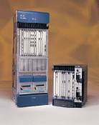
Cisco Gigabit Router
High throughput routers
  web site
  abandoned shared backplane
  now use crossbar switch at core
  caters for up to 2.4GBit/s links
  optical I/O
Notes:
This slide shows one of the latest offerings from Cisco in its high end router range. The Cisco 12000 router is designed as a fast internet router serving links which will eventually go up to 2.4GBit/s. The I/O will allow for optical interfaces.
Whereas most Cisco routers use a shared backplane, some form of fast Ethernet, the 12000 series uses a crossbar switch.
The web site pointed to here is:
http://www.cisco.com/warp/public/cc/cisco/mkt/core/12000/index.shtml
and a technical document describing fast routers can be found here:
http://www.cisco.com/warp/public/cc/cisco/mkt/core/12000/tech/fasts_wp.pdf

Slide 15
Next Lecture
Relationship of Data Link Layer to Network Layer
Error control
  Democratic voting strategies
  error detection and correction
  Parity
  Hamming distance and Hamming codes
  CRC codes
Framing
Notes:
In the next lecture we will discuss some of the ways for dealing with real transmission where errors are introduced.
First we look at a simple voting strategy for transmitting information on a noisey line. No explicit error control is used in this case.
We can distinguish between error detection, where for example an error can be detected but the nature of the error is unknown, and error correction where an error can both be detected and corrected. It is not possible to correct for all possible errors so error correction can only work for a range of possible errors. Different codes will be able to detect for different types of error and the selection of the most suitable code will depend on the details of the transmission line. In some cases, bursts of errors are much more likely than isolated errors but these can be accommodated.
We will also discuss the issue of framing which arises from the need of the data link layer to be able to tell when a sequence of bits starts and stops.

